Slide 1
Health Workforce Shortage Areas

Slide 2
Group Members:
Dhruvin Raval
Vrund Bhavsar
Yamini Prajapati
Zeel mendpara

Slide 3
Project Outline
Why Healthcare Analytics?
Problem Statement
Data Description
Dataset:
Data Visualization
Why Machine Learning
Challenges

Slide 4
Why Healthcare analytics?
Health care analytics allows for the examination of patterns in various healthcare data in order to determine how clinical care can be improved while limiting excessive spending. this can help improve the overall patient care offered in healthcare facilities.

Slide 5
Problem Statement
Health workforce shortage areas are geographic areas, populations, and facilities that have a shortage of outpatient primary care, dental, and mental health providers and services. These areas are designated by the Health Resources and Services Administration (HRSA), a federal agency in the United States Department of Health and Human Services.

Slide 6
Data Description
There are several types of shortage designations including:
Health Professional Shortage Areas (HPSAs)
Medically Underserved Areas and Populations (MUAPs)
Exceptional Medically Underserved Population (Exceptional MUPs)
Governor's-Designated Secretary-Certified Shortage Areas for Rural Health Clinics

Slide 7
Dataset:
The health workforce shortage area data in the included files represent the HPSA and MUAP (including Exceptional MUP) designation information at a single point in time.
https://www.kaggle.com/datasets/geobrando/health-professional-shortage-areas

Slide 9
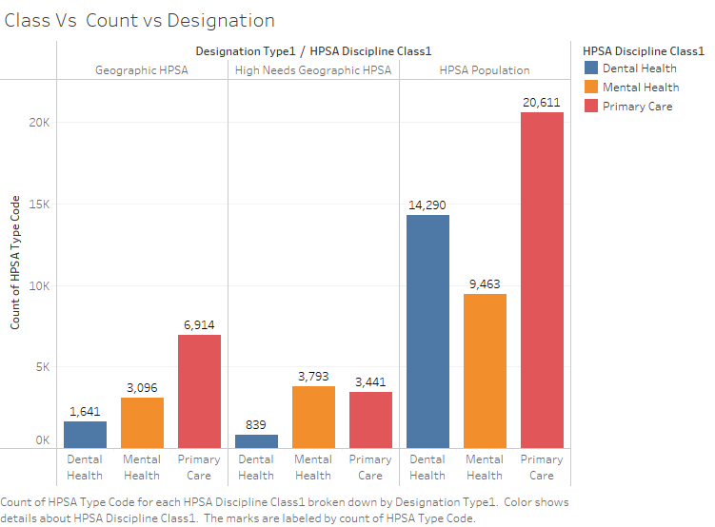

Slide 10
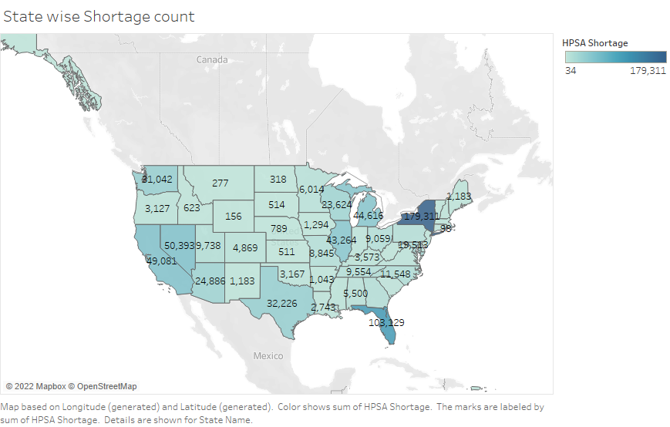

Slide 11
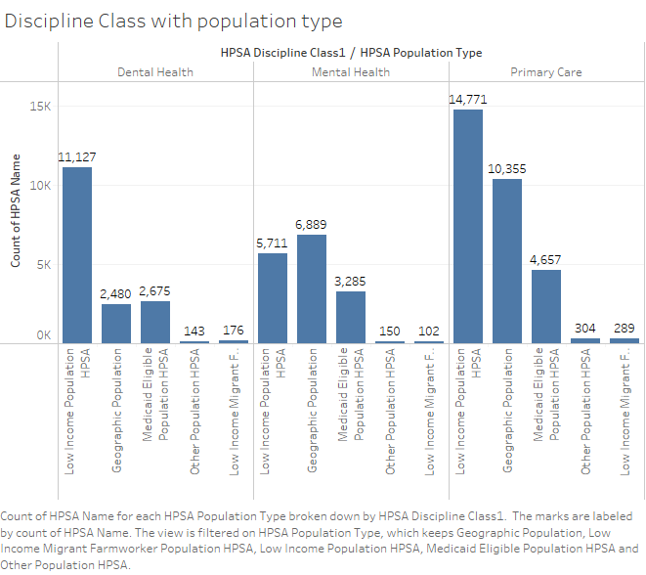

Slide 12
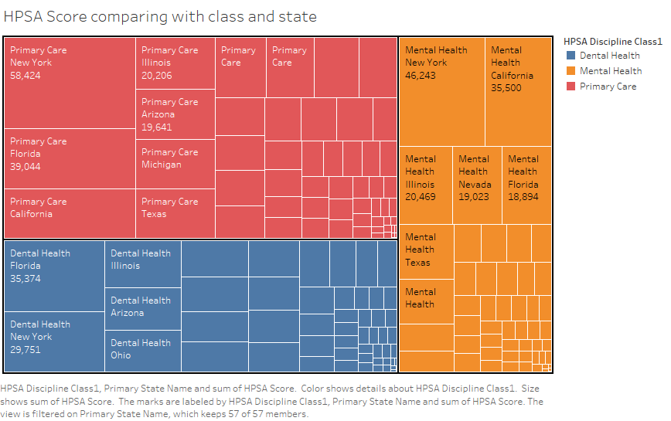

Slide 13
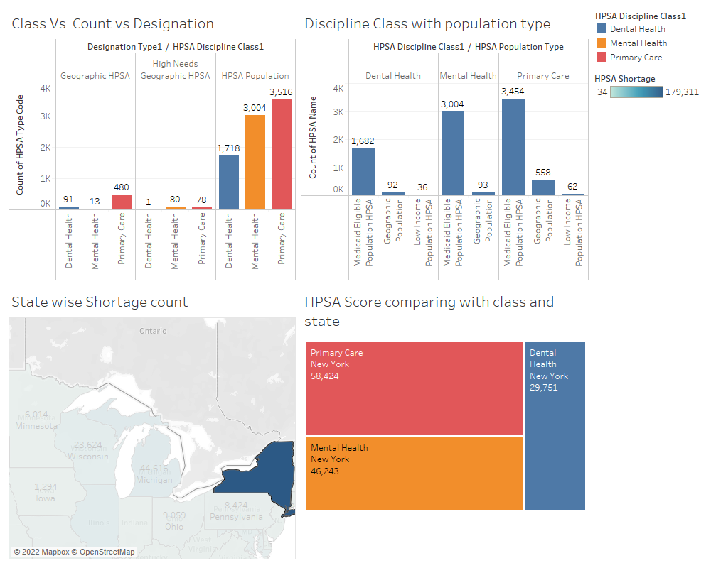

Slide 14
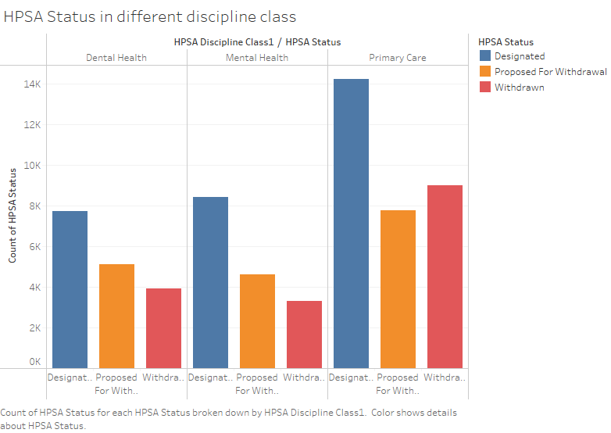

Slide 15
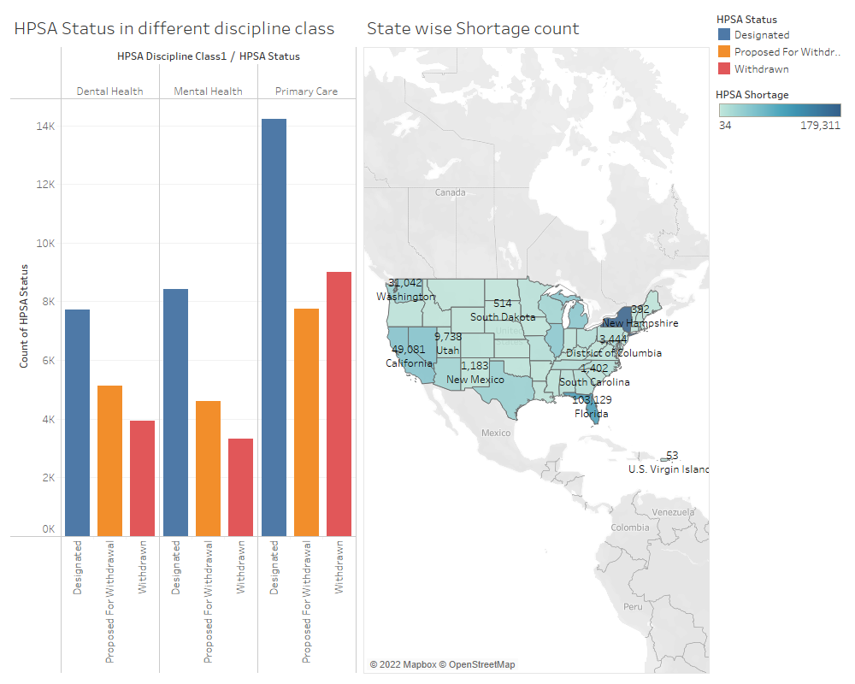

Slide 16
Why machine learning?

Slide 17
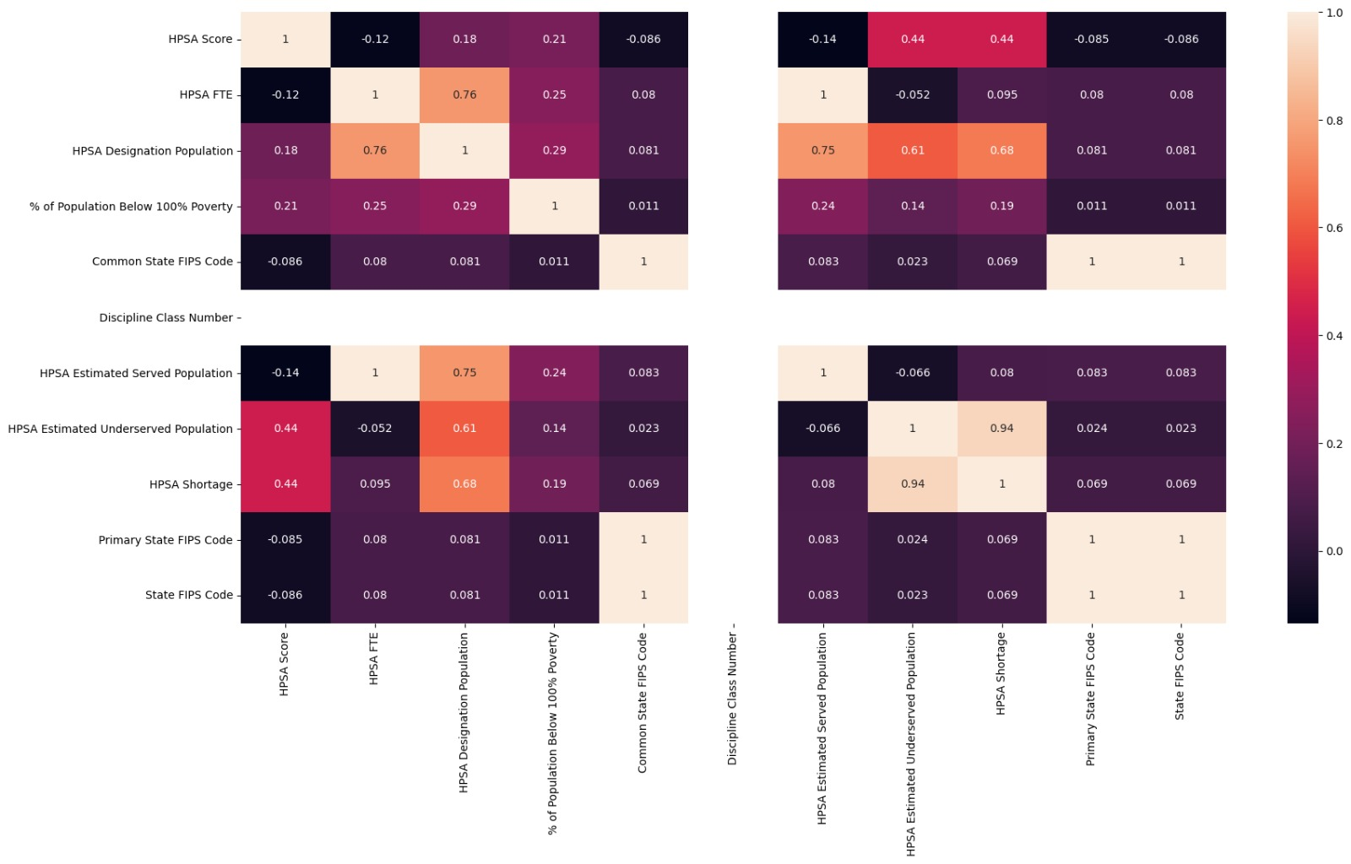

Slide 18
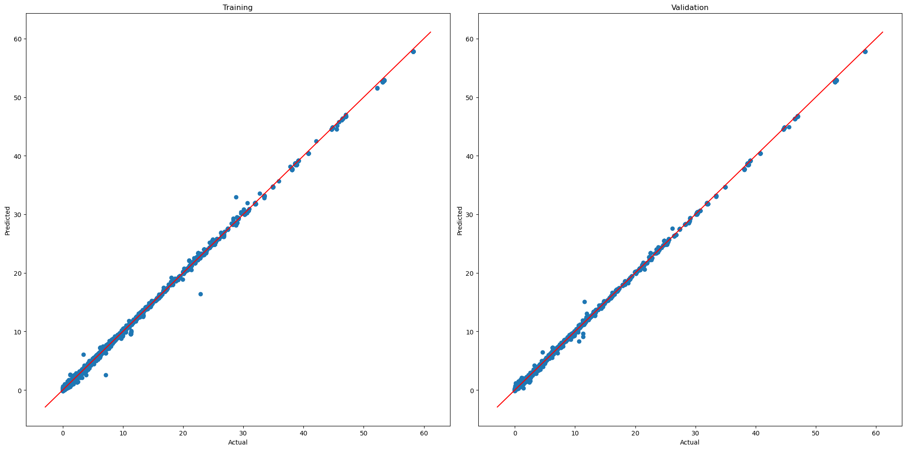
Predictions:

Slide 19
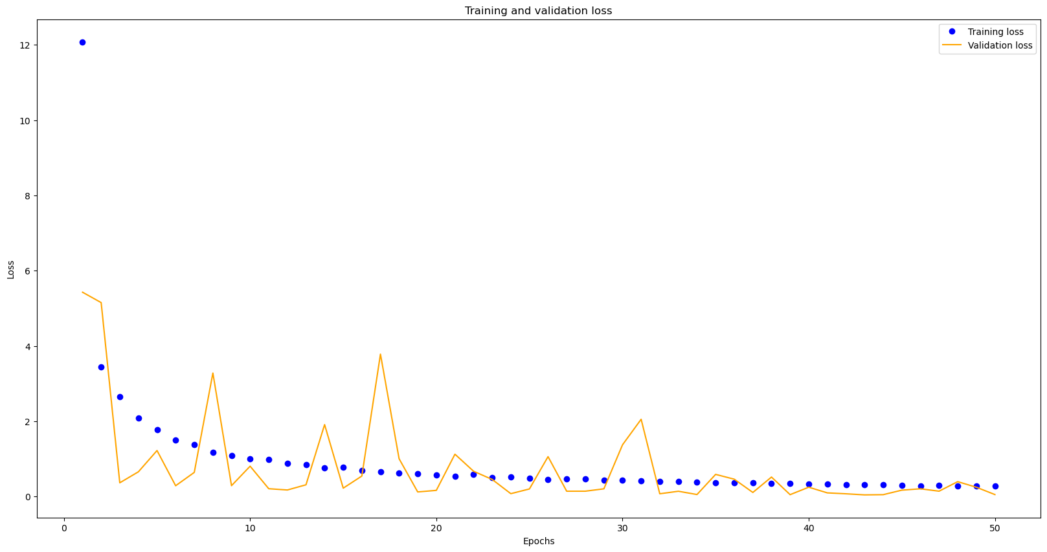

Slide 20
Challenges
Since we wanted to predict the case rather than just test a model's correctness, there were various difficulties encountered when creating the models.
While working on the tableau for the data visualisation, we did encounter some difficulties, but they were ultimately resolved with the assistance of some friends and the internet.

Slide 21
Thank you

